Slide 1
DCS X Peak AI
Olist
Team Four: Sandbox Analysis

Slide 2
TABLE OF CONTENTS
01
04
02
05
03
06
Our Team
Analysis
An overview of our team & backgrounds
Preparing the datasets, and analyzing the data
Exploring Problem
Modeling
Outline of defining an approach with the given information
Based on observations, modeling certain trends
Hypothesis
Conclusion
After planning, defining a hypothesis to work with
Drawing conclusions from analyses & models

Slide 3



Our Team
Oscar Wan
Varun Aravapalli
Nikita Pola
NYU CAS, class of ‘24
“Adapt and overcome.”
NYU Tandon, CS, class of ‘24
“I want to use and manipulate data to learn about the world” 🌎
NYU Tandon, CS, class of ‘24
“The power of data lies in its ability to analyze the past, and make decisions for the future” 💫

Slide 4

Exploring the Problem

Slide 5
The task at hand
Project
Sandbox Challenge
Impact
Understanding the customer preferences
Analysis
Conducted on orders, products and geolocation information

Slide 6

Planning
1st step
Look into datasets & entity relationship diagrams
2nd step
Support trends with models
Define a problem
3rd step
Feature selection/engineering and model building
4th step
Model analysis and recommendations

Slide 7
01
About the project

Slide 8
PROJECT GOALS
DATA
GOAL
How can OList Improve Customer Satisfaction?
What factors are most important to customer satisfaction?
FACTOR
“Influence User Reviews the most”

Slide 9
Manipulating the Data
Order_ID
Steps:
Merging Datasets
Removing Null Values
Engineering New Features
Product_ID
Location_Data

Slide 10
Correlation Heatmaps

Slide 11
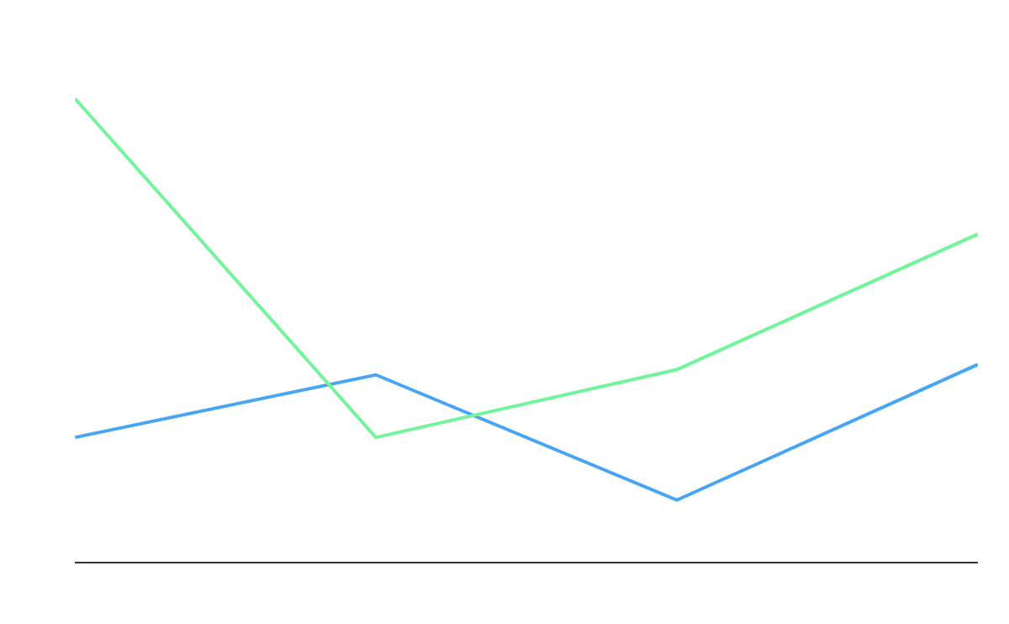
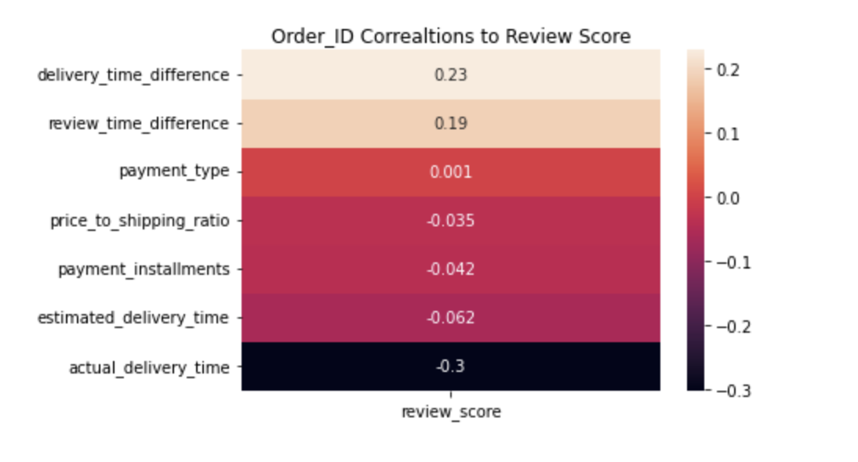
Order Attributes to Review Score
Summary
Little positive or negative correlation between review scores and location features

Slide 12
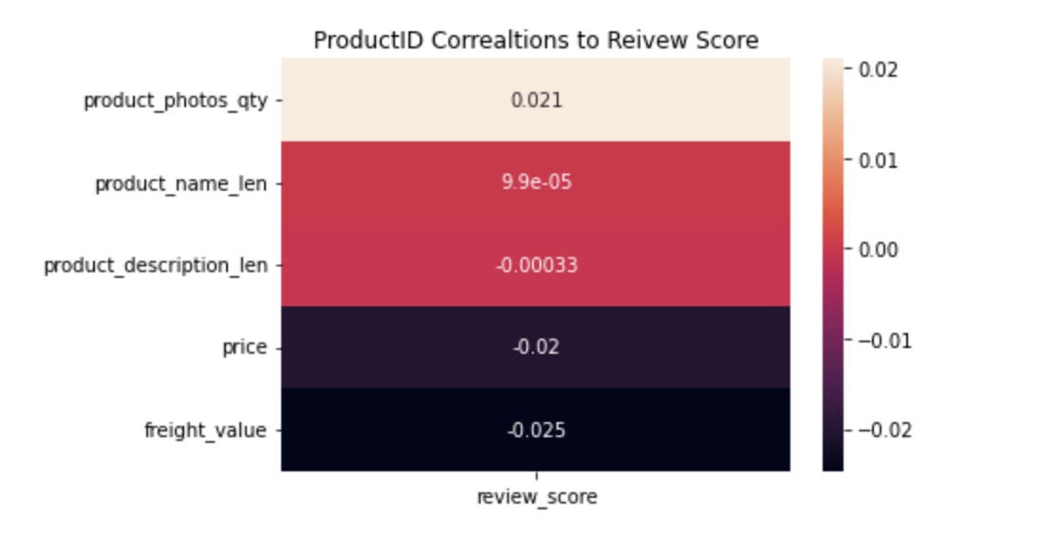
Product Attributes to Review Score
Summary
Little positive or negative correlation between review score and product attributes

Slide 13
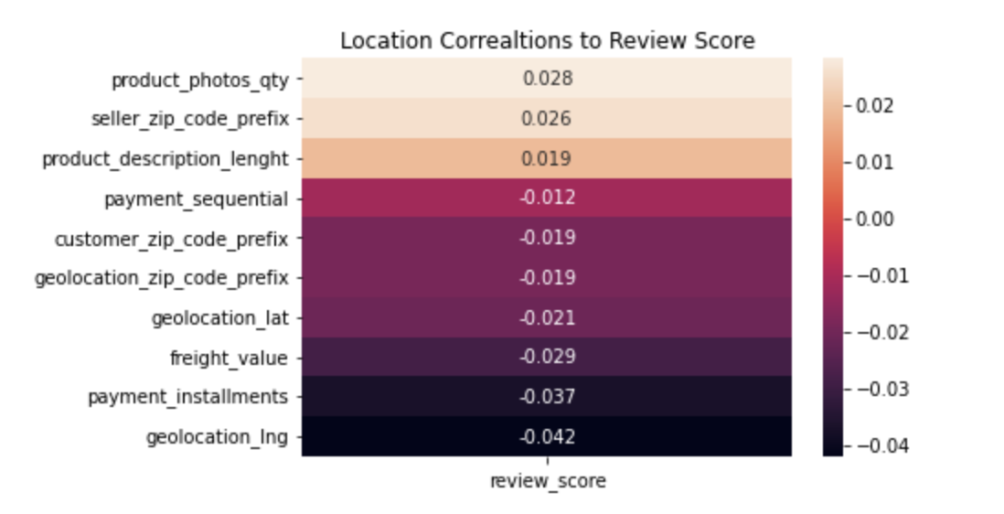
Location Attributes to Review Score
Summary
Little positive or negative correlation between review scores and location features

Slide 14
Logistic Regression
Target:
Whether a customer is satisfied with the order
If review rating < 4, then no (unsatisfied). Else, yes (satisfied).
Features:
Whether the order is delivered late compared to the estimated delivery time (is_late)
Shipping fee to item price ratio (shipping_cost)
Amount of time it took for Olist to ask for review on an order (review_time)
Number of photos of the product ordered (num_photos)

Slide 15
Reasoning on features selected
Whether order is delivered late: if there are delays in delivery, customer frustration would be greater
Review time difference: if the survey is sent shortly after delivery, users would more likely respond accurately (recency bias)
Product Photos Quantity: more information available (more photos) to the user, leads to more transparency in the transaction
Price to Shipping Ratio: customers might be unhappy with a high shipping cost if they buy something cheaper

Slide 16
Logistic regression
Is_late is the only strong factor
The coefficient of -1.786 means that an order being late makes a customer about 6 time LESS likely to be satisfied with the order than if the order were on time!
Olist should try to keep the orders delivered on time!
Feature | Coefficient
is_late | -1.786
shipping_cost | -0.298
review_time | 0.014
num_photo | 0.047

Slide 17
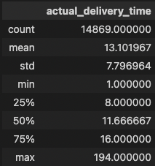
Delivery time across zip code
Some statistics of average delivery time across zip codes
On average, it takes almost 2 weeks to deliver an order to a customer (some packages took over 100 days, but they were shipped to outside of brazil)!

Slide 18
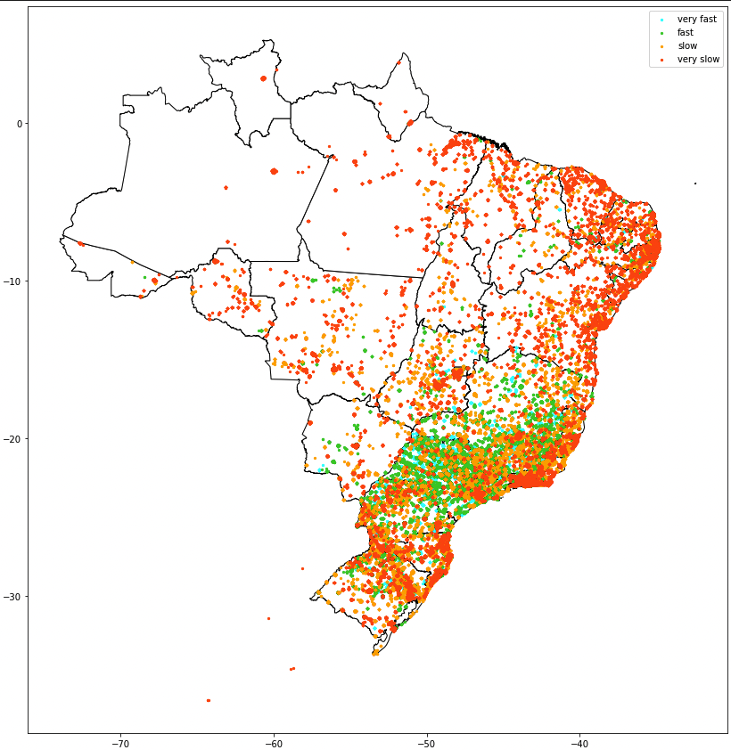
Delivery Time across Zip Codes (Cont.)
Red and orange indicate very slow (over 16 days), and slow (over 11 days) delivery
Delivery is very slow in most of the locations
We recommend Olist to add more shipping centers in these areas with high demand!

Slide 19
Recommendations
Potential considerations based on findings and analysis

Slide 20
POSSIBLE LOCATIONS
Natal
Capital city of Rio Grande
Salvador
Capital city of Bahia
Rio de Janeiro
Capital city of Brazil

Slide 21
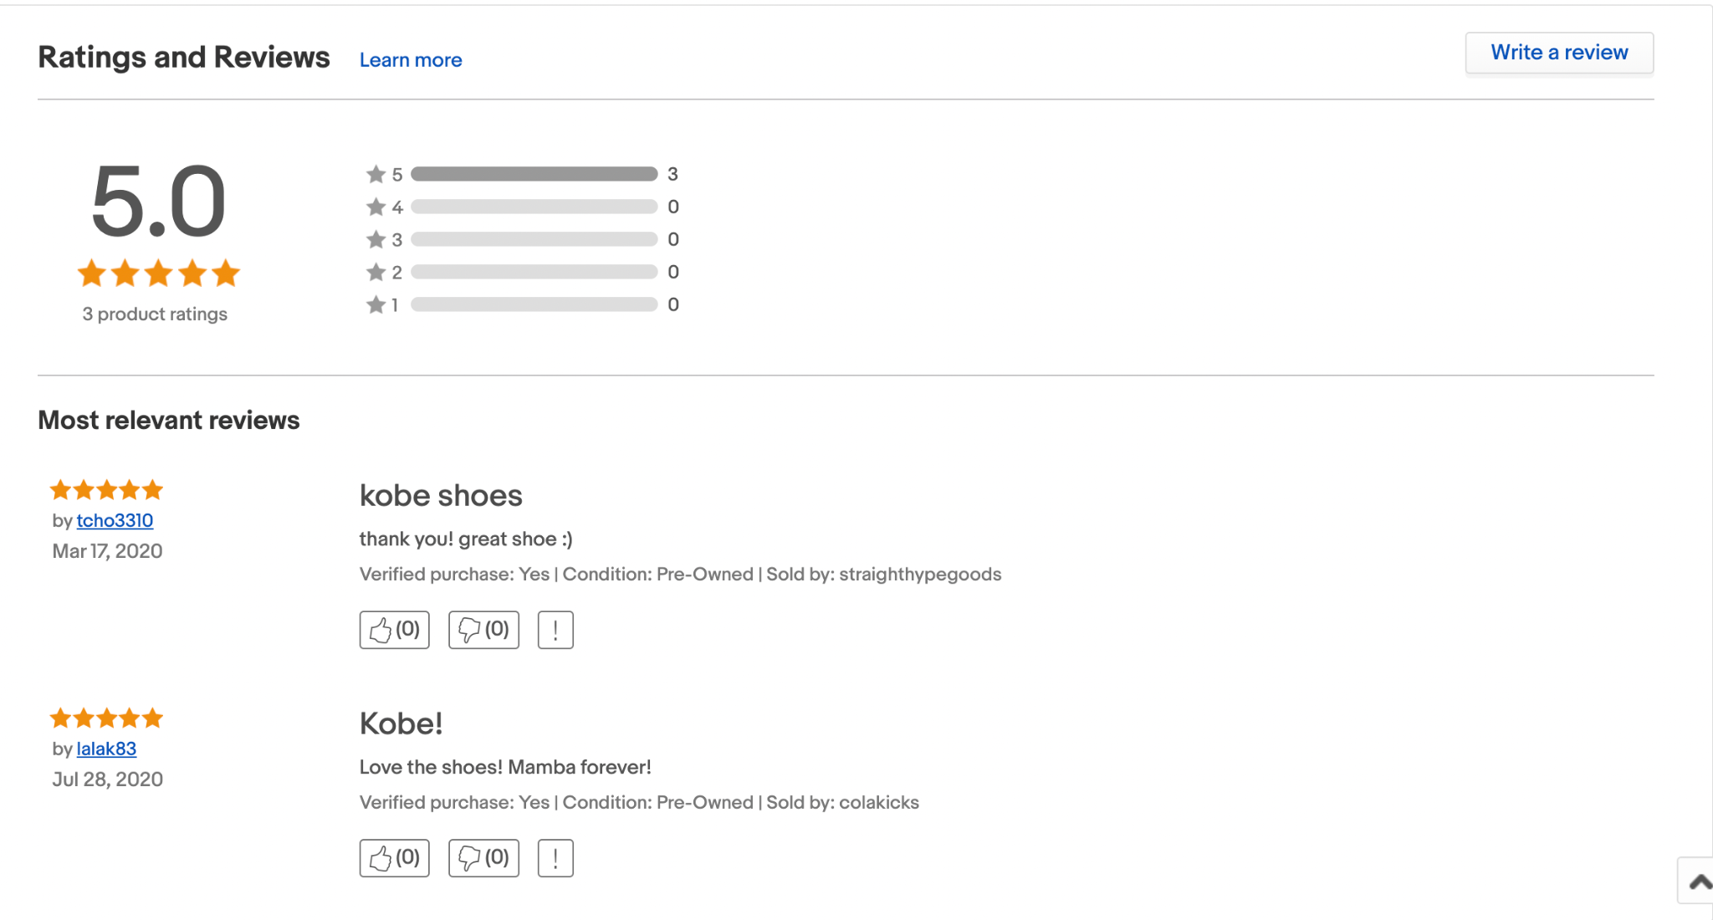
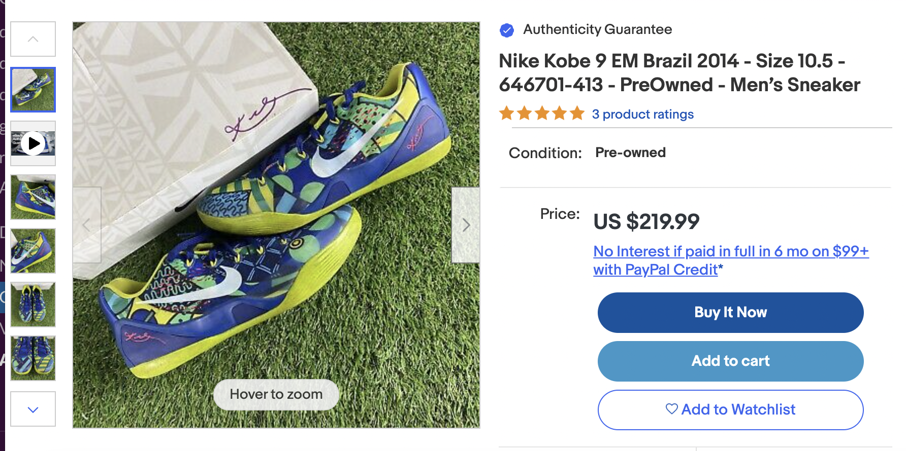
Alternative Recommendations
Add features for product reviews and seller reviews
Currently there is only order reviews (without mandated entries)
Obtain customer-specific data to find trends among customers and lead to customer-driven solutions based on targeted customer segments

Slide 22
Thanks for listening!

